Slide 1



Data Structure
&
Algorithm
Class X
lab 10

Slide 2


Selection Sort
an in-place comparison-based algorithm

Slide 3
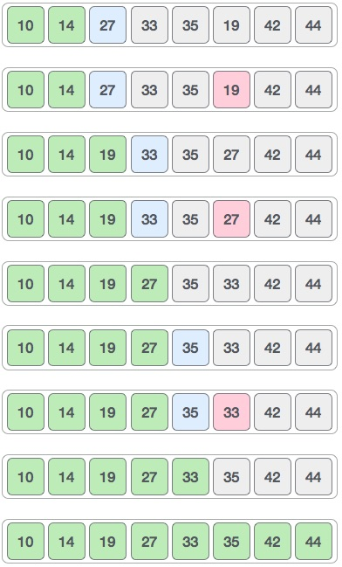
How it Works
entire sorting process

Slide 4
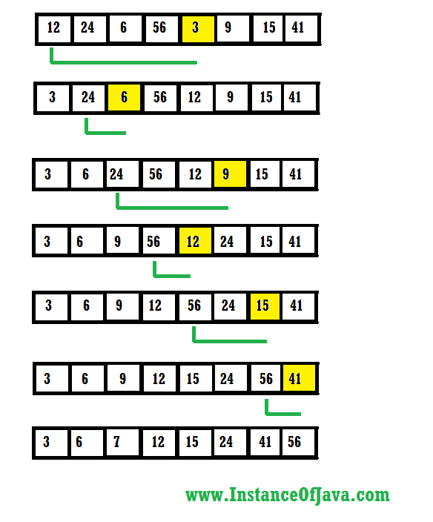
Example 1

Slide 5
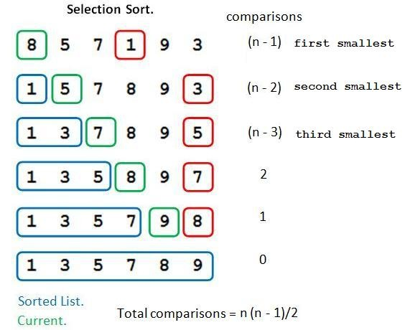
Example 2

Slide 6
Algorithm
Step 1 − Set MIN to location 0
Step 2 − Search the minimum element in the list
Step 3 − Swap with value at location MIN
Step 4 − Increment MIN to point to next element
Step 5 − Repeat until list is sorted

Slide 7


